Slide 1
WireCAD v8 Training
Fast Track to
Enlightenment,
World Peace and
General “Real Guy”-ness

Slide 2
Remember!!!
The F1 key opens the on-line help file.
Also check out the WireCAD wiki @ www.wirecad.com/wiki or from within WireCAD click Help>WireCAD wiki.

Slide 3
Agenda Day 1
Get all the way through a small
one-drawing project, soup to nuts.

Slide 4
Agenda Day 2
Fill in the holes we skipped over on Day 1
Notes:
Notes

Slide 5
About the Author
Christian Holbrook, President Holbrook Enterprises, Inc.
Christian has had a long and diverse career in the entertainment electronics industry.
Christian served as the chief engineer of several production, postproduction, and broadcast facilities.
Christian served recently as Director of Engineering for the Fox Family Channel.
Christian has owned consulting firms, integration firms and an electronics manufacturing company.
Christian has traded his breadboard for the software development environment and created WireCAD to fill a need many people experience in the system design/integration arena.

Slide 6
Overview
What for?

Slide 7
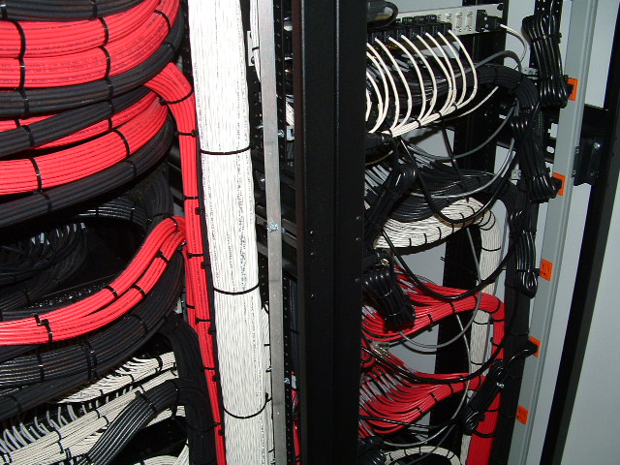
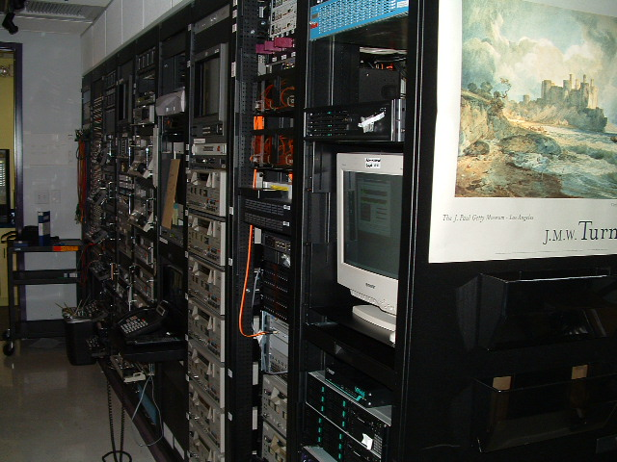
Installation Pictures

Slide 8
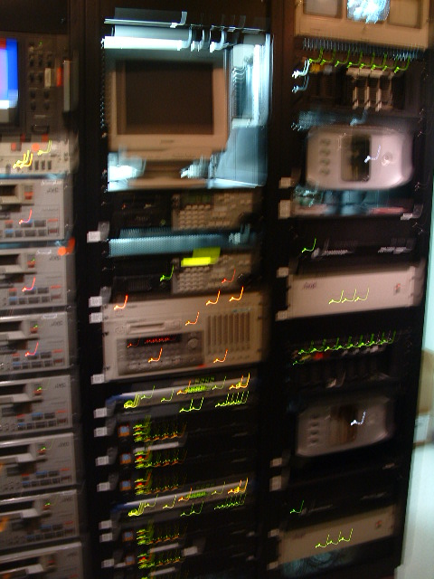
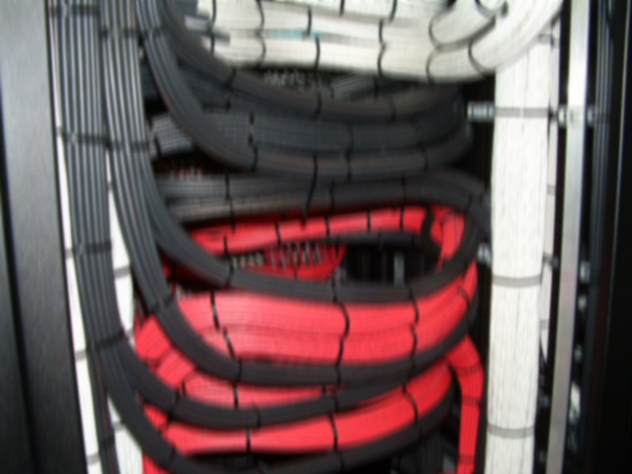
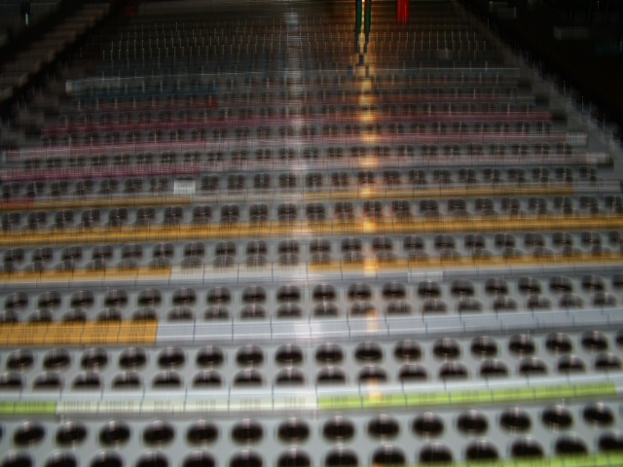
Recent Installations

Slide 9
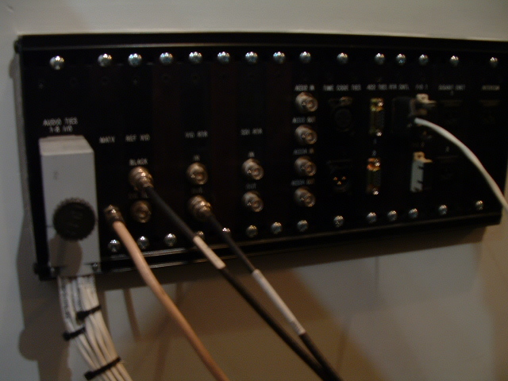
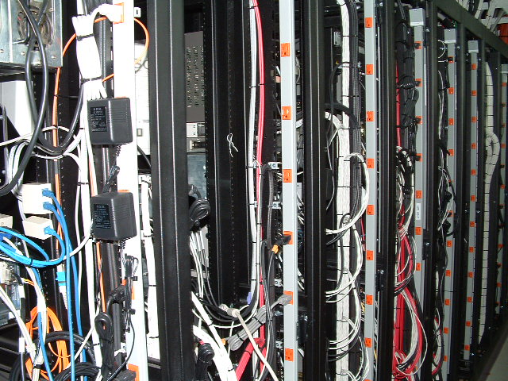
Installation Pictures

Slide 10
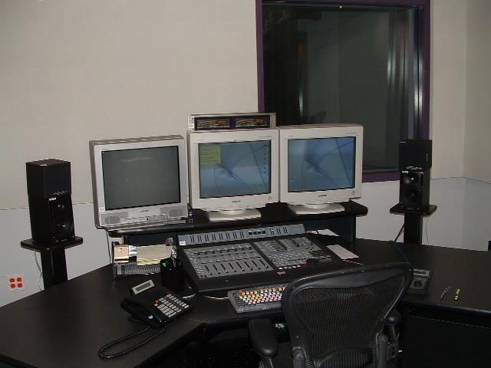
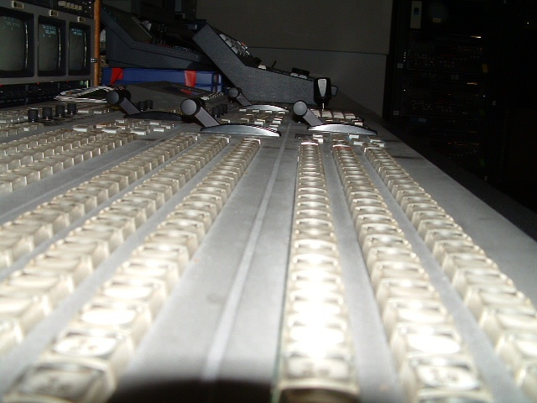
Installation Pictures
© 2010 Holbrook Enterprises, Inc. All Rights Reserved

Slide 11
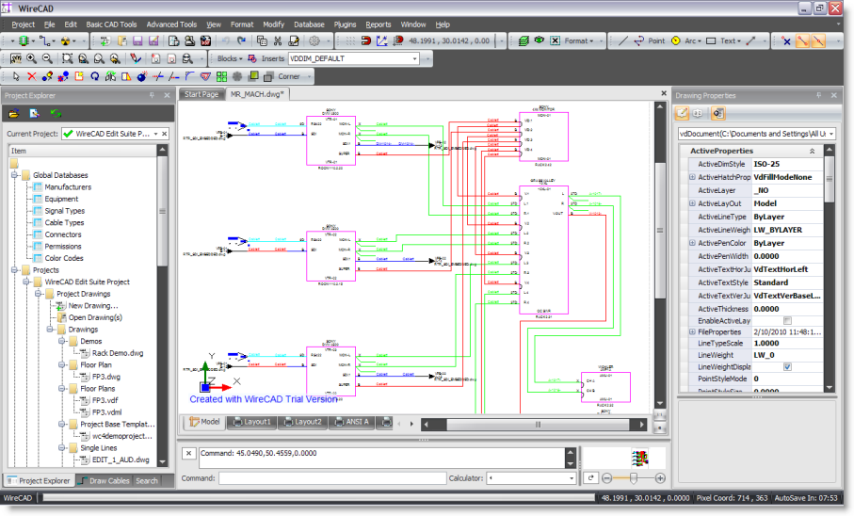
System Drawings

Slide 12
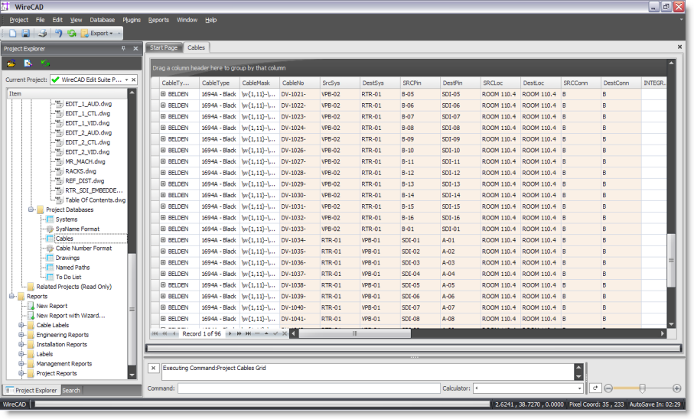
System Databases

Slide 13
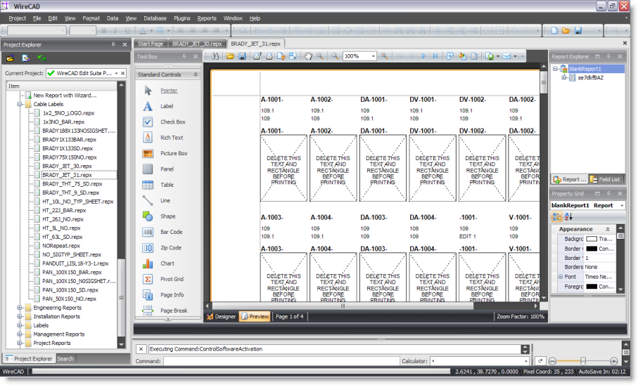
System Reports

Slide 14
File Based vs. Database
File based documentation relies on a single file or series of files to present data representing system documentation. Examples: Visio, AutoCAD, Excel.
Database based documentation provides a central repository for all of the data in the collection. Examples: Access, Foxpro, SQL Server.
Enter WireCAD - A Marriage of the Two.
Allows the presentation capabilities of the file based approach and the centralization of the database approach.

Slide 15
File Based vs. WireCAD
File Based
WireCAD
Cable numbers and system names are available only to the file
Cable numbers and system names are available to other drawings
Cannot Perform Global Error Checking
Allows Global Error Checking
Difficult to aggregate data for reporting
Data is already aggregated and can easily be reported on.
Cable numbers can be orphaned causing errors
Easy to erroneously duplicate system identifiers and cable numbers
Easy to control duplication of system identifiers and cable numbers

Slide 16
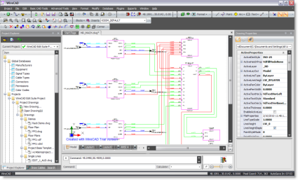
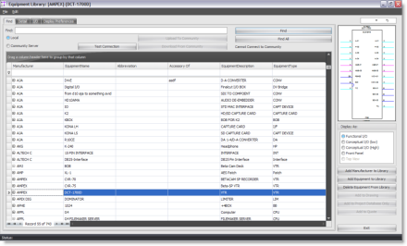
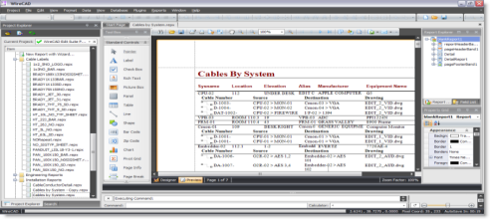
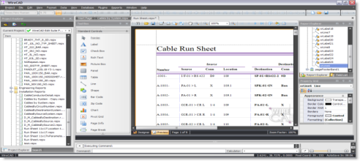
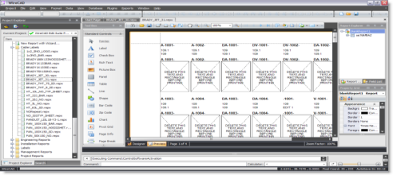
Concept
My Current Project
Equipment Library
Global
Databases
Project Database
Report Engine

Slide 17
Concept
My Current Project
Project Database
Equipment List
(bidirectional connection to drawings)
Cables Table
(bidirectional connection to drawings)

Slide 18
Global Database (WireCADGlobalEquipment.vdb3) VISTADB (WireCAD_Global_Equipment.mdf) SQL
Equipment
Inputs
Outputs
Manufacturers
Signal Types
Connectors
Cable Types
Industry Sectors
Global
Database

Slide 19
Project Database (YourProjectName.vdb3) VISTADB (YourProjectName.mdf) SQL*
Equipment List (SysNames)
Cables
Locations
Named Paths
Backbones (ENT only)
Circuits (ENT only)
Drawings
Discrepancies
Project
Database
*SQL database names cannot begin with numbers

Slide 20
Remember!!!
The F1 key opens the on-line help file.
Also check out the WireCAD wiki @ www.wirecad.com/wiki or from within WireCAD click Help>WireCAD wiki.

Slide 21
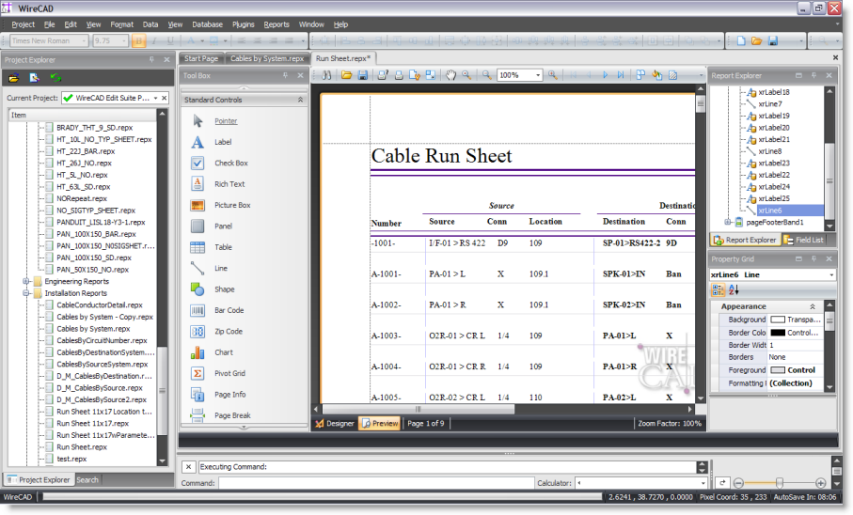
Report File Concept *.repx
Global
Databases
*.repx
Retrieves and
formats data
supplied by
the various
databases.
Project
Databases

Slide 22
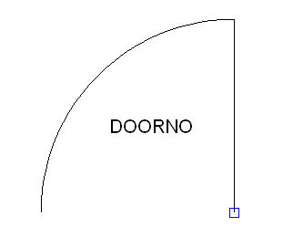
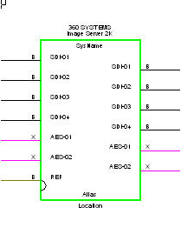
CAD Vocabulary
Entity – raw drawing component: lines, circles, rectangles, text, images, etc.
Block, Block, or Block????
A grouping of entities that can be inserted at multiple locations in the drawing.
A grouping of entities that represent the inputs and outputs for an electronic device.
A grouping of entities that represents a terminal block.
A toddler’s toy.
Insert – An instance of a block (sometimes erroneously referred to as a block)

Slide 23
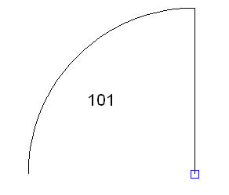
CAD Vocabulary continued
Text – raw drawing component: lines, circles, rectangles, text, images, etc.
Attribute
A Tag/Value pair where the Tag represents a descriptor of the data contained in the Value.
Attributes behave differently when added to a Block. When outside a block the Tag string is displayed. After inclusion in a block the Value string is displayed.
Example: An attribute with the Tag set to DoorNo and the Value set to 101 will display DoorNo until included in a Block. Whereupon the Value, 101, will be displayed.

Slide 24
CAD Vocabulary continued
Jack, Terminal, Pointer – Collectively referred to as “Terminals” within WireCAD.
Note: The distinction between each terminal type determines programmatic behaviour. For example, inserting a terminal that represents a pointer will cause the program to attempt to link one pointer to another when a pointer is double-clicked.
SysName – Unique system identifier or key field. Format can be defined by user.
CableNo – Cable number that uniquely identifies each cable. Format can be defined by user

Slide 25
Drawing File
Visible Drawing Tables
Invisible Drawing Tables
Text
Styles
Layers
Model Space
Dim
Styles
Blocks
Paper Space

Slide 26
Drawing Spaces
The CAD file organizes view into two basic drawing spaces: Model and Paper(2K allows for multiple paper spaces called layouts).
The Model space is where the actual model or drawing is drawn.
The Paper space provides opportunity to lay up different views to print.

Slide 27
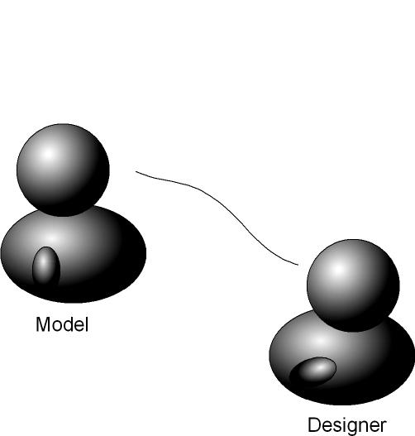
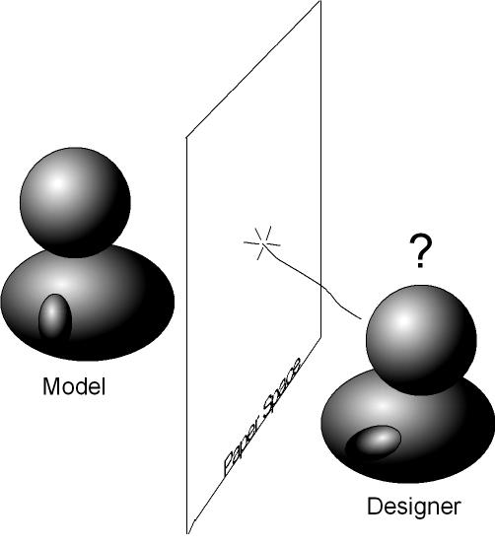
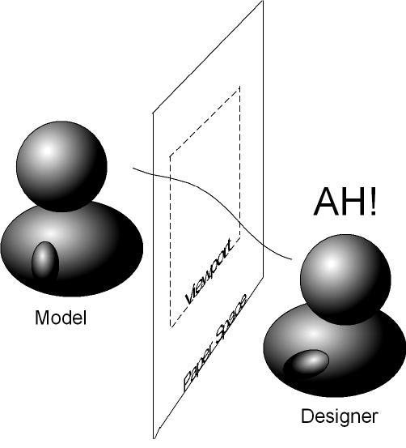
Drawing Spaces

Slide 28
END

Slide 29
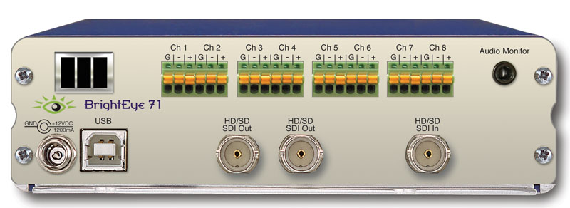
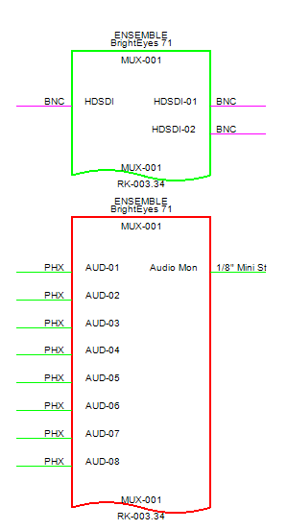
MUX-01
SysName Concept
MUX-01
Same Device
MUX-01

Slide 30
SysName Concept Advanced
MUX-01 @ Location A
MUX-01 @ Location B
MUX-01 @ Location A
MUX-01 @ Location B
Same Device
Same Device
Different Devices – SysName/Location Pair Differ

Slide 31
END

Slide 32
Why Packup and Go?
You are getting ready to hand the project off to your client.
You want to create backups.
You want to move the project to another machine.

Slide 33
Packup and Go Process
Packup Started
Project Folder
Copy Global db
Sync w/ Global db
Copy drawing
dependencies
Project
DB
Drawings
Compress Folder
Global
DB
Global
DB

Slide 34
Unpack SQL databases
Packup Started
Project Folder
Sync w/ Global db
Sync w/ Project db
Project
DB
Drawings
Global
DB
Global
DB
Project
DB SQL

Slide 35
Unpack VISTADB databases
Packup Started
Project Folder
Sync w/ Global db
Project
DB
Drawings
Global
DB
Global
DB

Slide 36
To Check-out or Not?
You are given the choice on Packup to Check-out the project. This is typically done with SQL Server projects. The process does not change. The only difference is the project is flagged as checked out and is Read-Only until it is checked back in.

Slide 37
END

Slide 38
Database Format Decision
Item | SQL Server | VistaDB
File Based |  | X
Server Based | X
Zero Administration |  | X
Portable |  | X
ACID Compliant (atomicity, consistency, isolation, durability) | X | X
Database Size | Theoretically unlimited | Practical limit is based upon machine resources. Loading very large databases will require large system resources.
In Process Processing |  | X

Slide 39
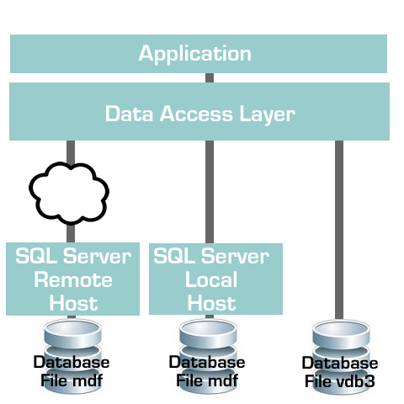
Database Format Decision

Slide 40
Database Format Decision
Will I be moving the project from machine to machine? If yes, consider staying file based on the project.
Do I have the chops to manage a SQL Server? If no, stay file based. SQL Server requires care and feeding.
Am I away from my network when I work on WireCAD projects? If you lose connection, WireCAD will become hampered.
Do I really need the speed enhancements? If you are working on projects with hundreds of thousands of cables, SQL Server is a must.

Slide 41
END

Slide 42
Common Paths
XP: Executables C:\Program Files\WireCAD7 Shared Program Files C:\Documents and Settings\All Users\Documents\WireCAD\WireCAD7 User Data C:\Documents and Settings\YOURUSERNAME\Local Settings\Application Data\WireCAD\WireCAD7
VISTA / 7 / 8: Executables C:\Program Files\WireCAD7 Shared Program Files C:\Users\Public\Documents\WireCAD\WireCAD7 User Data C:\Users\cbh\AppData\Local\WireCAD\WireCAD7

Slide 43
Demo Project Path
XP: C:\Documents and Settings\All Users\Documents\WireCAD\WireCAD7\
WireCAD Demo Project\ VISTA / 7 / 8: C:\Users\Public\Documents\WireCAD\
WireCAD7\WireCAD Demo Project\

Slide 44
MACHINE_ROOM Drawing Path
XP: C:\Documents and Settings\All Users\Documents\WireCAD\WireCAD7\
WireCAD Demo Project\Drawings\Single Lines\MACHINE_ROOM.dwg VISTA / 7 / 8: C:\Users\Public\Documents\WireCAD\
WireCAD7\WireCAD Demo Project\ Project\Drawings\Single Lines\MACHINE_ROOM.dwg

Slide 45
END

Slide 46
The Device’s Saved Settings
Used if they exist and are not overridden by project preferences
Only exist if the device has been added to a drawing.
Library Display Properties Hierarchy
Your Saved Project Settings
Used if no Device settings and if they exist.
Only exist if you have clicked the button to create them.
WireCAD Default Settings
Used by default if no project or device level settings exist

Slide 47
END

Slide 48
SDI Router

